Slide 1
Text classification
Natural Language Processing

Slide 2
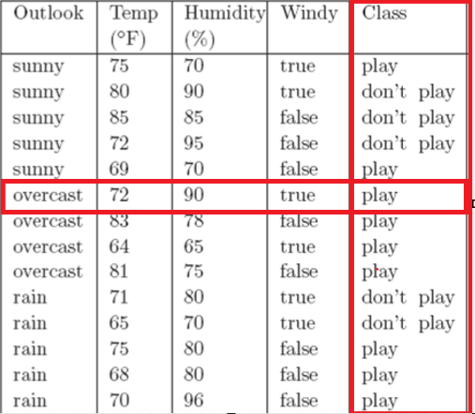
Basic Terminologies
Dataset, attributes/features, label/class

Slide 3
Basic Terminologies
Dataset, document, attributes/features, label/class
Text | Lebel
...zany characters and richly applied satire, and some great plot twists | pos
It was pathetic. The worst part about it was the boxing scenes... | neg
...awesome caramel sauce and sweet toasty almonds. I love this place! | pos
...awful pizza and ridiculously overpriced... | neg

Slide 4
Classification
Classification is one form of prediction, where the value to be predicted is a label.
The goal of classification is to take a single observation, extract some useful features, and thereby classify the observation into one of a set of discrete classes.
Outlook=sunny | Temp=79 | Humidity=88 | Windy=false | Class=?

Slide 5
Text Classification
Text classification is the task of assigning a label (categories, topics, or genres) to an entire text or document.
Spam detection
Authorship identification (who wrote this?)
Language Identification (is this Portuguese?)
Sentiment analysis (focus of this lecture)
…
Input:
a document d
a fixed set of classes C = {c₁, c₂,…, c_{J}}
Output: a predicted class c ∈ C

Slide 6
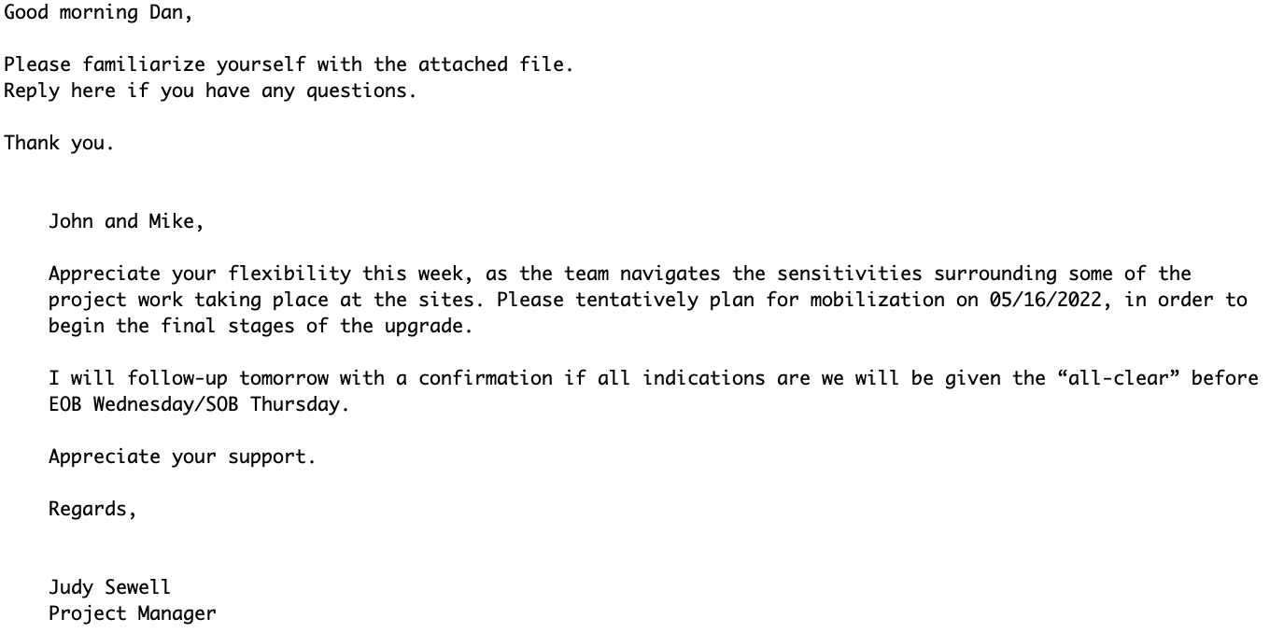
Spam Detection
Is this spam or not?
Labels: “spam” and “not spam”
Binary classification task

Slide 7
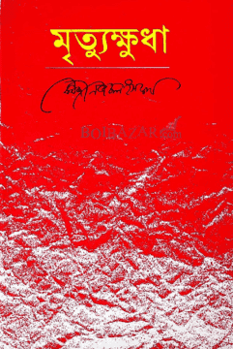


Authorship Attribution
sdfsd
Kazi Nazrul Islam
Rabindranath Tagore
???

Slide 8
Article Categorization
MEDLINE Article
MeSH Subject Category Hierarchy
Antogonists and Inhibitors
Blood Supply
Chemistry
Drug Therapy
Embryology
Epidemiology
…
?

Slide 9
Sentiment Analysis
The simplest version of sentiment analysis is a binary classification task, and the words of the review provide excellent cues.
Consider, for example, the following phrases extracted from positive and negative reviews of movies and restaurants.
Words like great, richly, awesome, and pathetic, and awful and ridiculously are very informative cues.
Text | Lebel
...zany characters and richly applied satire, and some great plot twists | pos
It was pathetic. The worst part about it was the boxing scenes... | neg
...awesome caramel sauce and sweet toasty almonds. I love this place! | pos
...awful pizza and ridiculously overpriced... | neg
This burger is pathetic. | ???

Slide 10
Sentiment Analysis Methods
A rule-based algorithm composed by a human (e.g., VADER scikit-learn)
A machine learning model based on data (e.g., Naive Bayes scikit-learn)

Slide 11
Rule Based Approach
Rules based on combinations of words or other features
spam: black-list-address OR (“dollars” AND “have been selected”)
Accuracy can be high
In very specific domains
If rules are carefully refined by experts
But:
rules can be fragile, as situations or data change over time
building and maintaining rules is expensive
they are too literal and specific: "high-precision, low-recall"

Slide 12
Machine Learning Approach
Machine learning, relies on a labeled set of statements or documents to train a machine learning model to create rules.
A machine learning sentiment model is trained to process input text and output a numerical value for the sentiment we are trying to measure. This approach is known as supervised machine learning.
Input:
a document d
a fixed set of classes C = {c₁, c₂,…, c_{J}}
A training set of m hand-labeled
documents (d₁,c₁),....,(d_{m},c_{m})
Output:
a learned classifier γ:d → c
Many kinds of classifiers!
Naïve Bayes (this lecture)
k-nearest neighbors
Logistic regression
Neural networks
…

Slide 13
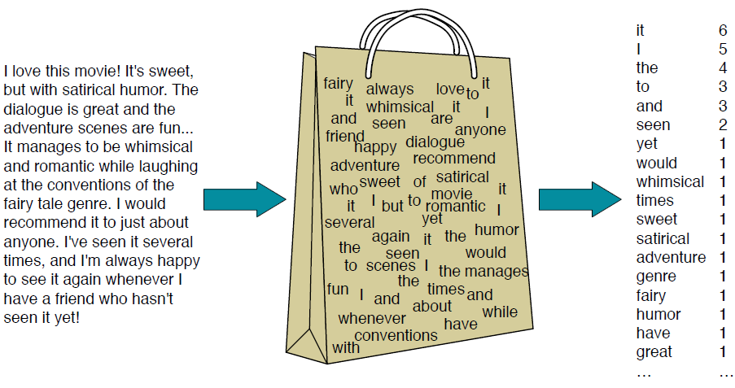
Bag of Words (BoW)
A bag of words is an unordered set of words whose position is ignored, keeping only their frequency in the document.
Notes:
In the example in the figure,
instead of representing the word order in all the phrases like “I love this movie” and
“I would recommend it”, we simply note that the word I occurred 5 times in the
entire excerpt, the word it 6 times, the words love, recommend, and movie once, and
so on.

Slide 14

Naive Bayes Classifier
This method is based on Bayes’ rule.
It relies on BoW representation.
Naive Bayes is a probabilistic classifier, meaning that for a document d, out of all classes c ∈ C the classifier returns the class c which has the maximum posterior probability given the document.

Slide 15
Naive Bayes Classifier

Slide 16

Naive Bayes Classifier
we want to predict the class (c)
this is our test document d

Slide 17
Naive Bayes Classifier
C = {c1, c2}
c1 = “-”
c2 = “+”
d = “predictable with no fun”
Anyone of these two will be
d

Slide 18
Naive Bayes Classifier
C = {c1, c2}
c1 = “-”
c2 = “+”
d = “predictable with no fun”
Anyone of these two will be
d
Why conditional probability P(c|d)?

Slide 19
Naive Bayes Classifier
C = {c1, c2}
c1 = “-”
c2 = “+”
d = “predictable with no fun”
Anyone of these two will be
d
Why P(c|d)? Because we want to find the probability value for (c1 & c2)
“if document d=‘predictable with no fun’, then what is the value of class c”

Slide 20
Naive Bayes Classifier
C = {c1, c2}
c1 = “-”
c2 = “+”
d = “predictable with no fun”
P(c1|d) = P(“-” | “predictable with no fun”)
P(c2|d) = P(“+” | “predictable with no fun”)
Why P(c|d)? Because we want to find the probability value for (c1 & c2)
“if document d=‘predictable with no fun’, then what is the value of class c”

Slide 21
Naive Bayes Classifier
C = {c1, c2}
c1 = “-”
c2 = “+”
d = “predictable with no fun”
P(c1|d) = P(“-” | “predictable with no fun”)
P(c2|d) = P(“+” | “predictable with no fun”)
Why argmax?

Slide 22
Naive Bayes Classifier
C = {c1, c2}
c1 = “-”
c2 = “+”
d = “predictable with no fun”
P(c1|d) = P(“-” | “predictable with no fun”)
P(c2|d) = P(“+” | “predictable with no fun”)
Why argmax? Among multiple values, it selects the highest value. Our target is to select the class for which we obtain the highest probability.

Slide 23
Naive Bayes Classifier
C = {c1, c2}
c1 = “-”
c2 = “+”
d = “predictable with no fun”
P(c1|d) = P(“-” | “predictable with no fun”)
P(c2|d) = P(“+” | “predictable with no fun”)
argmax [P(“-” | “predictable with no fun”), P(“+” | “predictable with no fun”)] from this expression, select a class that has the highest probability.

Slide 24
Naive Bayes Classifier

Slide 25

Naive Bayes Classifier
Bayes’ rule

Slide 26
Naive Bayes Classifier
Bayes’ rule

Slide 27
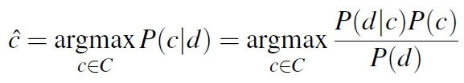
Naive Bayes Classifier
Bayes’ rule

Slide 28
Naive Bayes Classifier
ignore denominator P(d)

Slide 29
Naive Bayes Classifier
ignore denominator P(d)

Slide 30
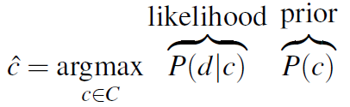
Naive Bayes Classifier
ignore denominator P(d)

Slide 31
Naive Bayes Classifier

Slide 32
Naive Bayes Classifier
A document d is represented as a set of features f₁, f₂, …, f_{n}
d = f₁, f₂, …, f_{n}
d = “predictable with no fun”
“predictable with no fun” = {“predictable”, “with”, “no”, “fun”}
f₁ = “predictable”, f₂ = “with”,
f₃ = “no”, f₄ = “fun”
hence, d = {f₁, f₂, f₃, f₄}

Slide 33
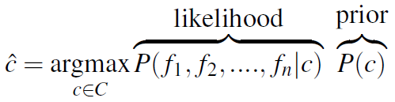
Naive Bayes Classifier
A document d is represented as a set of features f₁, f₂, …, f_{n}
d = f₁, f₂, …, f_{n}
d = “predictable with no fun”
“predictable with no fun” = {“predictable”, “with”, “no”, “fun”}
f₁ = “predictable”, f₂ = “with”,
f₃ = “no”, f₄ = “fun”
hence, d = {f₁, f₂, f₃, f₄}

Slide 34

Naive Bayes Classifier
A document d is represented as a set of features f₁, f₂, …, f_{n}
d = f₁, f₂, …, f_{n}
d = “predictable with no fun”
“predictable with no fun” = {“predictable”, “with”, “no”, “fun”}
f₁ = “predictable”, f₂ = “with”,
f₃ = “no”, f₄ = “fun”
hence, d = {f₁, f₂, f₃, f₄}

Slide 35
Naive Bayes Classifier (Assumptions)
To calculate P(f₁, f₂, …, f_{n}|c), Naive Bayes classifiers make two simplifying assumptions.

Slide 36
Naive Bayes Classifier (Assumptions)
To calculate P(f₁, f₂, …, f_{n}|c), Naive Bayes classifiers make two simplifying assumptions.
Bag of Words assumption: we assume feature position doesn’t matter

Slide 37
Naive Bayes Classifier (Assumptions)
To calculate P(f₁, f₂, …, f_{n}|c), Naive Bayes classifiers make two simplifying assumptions.
Bag of Words assumption: we assume feature position doesn’t matter
naive Bayes assumption: this is the conditional independence assumption that the probabilities P(f_{i}|c) are independent given the class c.

Slide 38

Naive Bayes Classifier (Assumptions)
To calculate P(f₁, f₂, …, f_{n}|c), Naive Bayes classifiers make two simplifying assumptions.
Bag of Words assumption: we assume feature position doesn’t matter
naive Bayes assumption: this is the conditional independence assumption that the probabilities P(f_{i}|c) are independent given the class c.

Slide 39
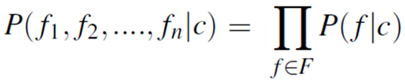
Naive Bayes Classifier (Assumptions)
To calculate P(f₁, f₂, …, f_{n}|c), Naive Bayes classifiers make two simplifying assumptions.
Bag of Words assumption: we assume feature position doesn’t matter
naive Bayes assumption: this is the conditional independence assumption that the probabilities P(f_{i}|c) are independent given the class c.

Slide 40
Naive Bayes Classifier
Let’s back to our equation simplification

Slide 41

Naive Bayes Classifier
Let’s back to our equation simplification

Slide 42
Naive Bayes Classifier
To apply the naive Bayes classifier to text, we will use each word in the documents as a feature, and we consider each of the words in the document by walking an index through every word position in the document.

Slide 43
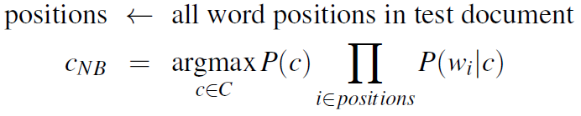
Naive Bayes Classifier
To apply the naive Bayes classifier to text, we will use each word in the documents as a feature, and we consider each of the words in the document by walking an index through every word position in the document.
d = “predictable with no fun”
d = {w₁, w₂, w₃, w₄}
w₁ = “predictable”, w₂ = “with”, w₃ = “no”, w₄ = “fun”

Slide 44

Naive Bayes Classifier
To apply the naive Bayes classifier to text, we will use each word in the documents as a feature, and we consider each of the words in the document by walking an index through every word position in the document.
Naive Bayes calculations, like calculations for language modeling, are done in log space, to avoid underflow and increase speed.

Slide 45
Naive Bayes Classifier
Now we have the following simplified equation. We need to calculate P(c) and P(w_{i}|c) to make our prediction.
This is the simplification of P(c|d)
P(“-” | “predictable with no fun”) = P(“-”)* P(“predictable”|“-”)*P(“with”|“-”)*P(“no”|“-”)*P(“fun”|“-”)
argmax[P(“-” | “predictable with no fun”), P(“+” | “predictable with no fun”)]
argmax[P(“-”)* P(“predictable”|“-”)*P(“with”|“-”)*P(“no”|“-”)*P(“fun”|“-”),
P(“+”)* P(“predictable”|“+”)*P(“with”|“+”)*P(“no”|“+”)*P(“fun”|“+”)]

Slide 46

Naive Bayes Classifier
Learn P(c). Let N_{c} be the number of documents in our training data with class c and N_{doc} be the total number of documents.

Slide 47
Naive Bayes Classifier
Learn P(c). Let N_{c} be the number of documents in our training data with class c and N_{doc} be the total number of documents.

Slide 48
Naive Bayes Classifier
Learn P(c). Let N_{c} be the number of documents in our training data with class c and N_{doc} be the total number of documents.
P(+) = 2/5
P(-) = 3/5

Slide 49

Naive Bayes Classifier
Learn P(w_{i}|c)

Slide 50
Naive Bayes Classifier
Learn P(w_{i}|c)
The vocabulary V consists of the union of all the word types in all classes, not just the words in one class c.

Slide 51
Naive Bayes Classifier
Learn P(w_{i}|c)
P(“predictable”|-) = ?
The vocabulary V consists of the union of all the word types in all classes, not just the words in one class c.

Slide 52
Naive Bayes Classifier
Learn P(w_{i}|c)
P(“predictable”|-) = 1/14
The vocabulary V consists of the union of all the word types in all classes, not just the words in one class c.

Slide 53
Naive Bayes Classifier
Learn P(w_{i}|c)
P(“predictable”|-) = 1/14
P(“fun”|-) = 0/14 = 0
The vocabulary V consists of the union of all the word types in all classes, not just the words in one class c.

Slide 54
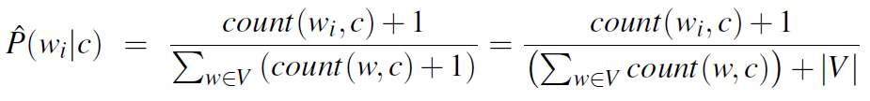
Naive Bayes Classifier
Learn P(w_{i}|c)
The vocabulary V consists of the union of all the word types in all classes, not just the words in one class c.
Laplace smoothing

Slide 55
Naive Bayes Classifier
P(“predictable”|-) = (1+1)/(14+20)
P(“no”|-) = (1+1)/(14+20)
P(“fun”|-) = (0+1)/(14+20)

Slide 56
Naive Bayes Classifier
P(“predictable”|-) = (1+1)/(14+20)
P(“no”|-) = (1+1)/(14+20)
P(“fun”|-) = (0+1)/(14+20)
P(“predictable”|+) = (0+1)/(9+20)
P(“no”|+) = (0+1)/(9+20)
P(“fun”|+) = (1+1)/(9+20)

Slide 57
Naive Bayes Classifier
argmax[P(“-” | “predictable with no fun”), P(“+” | “predictable with no fun”)]
argmax[P(“-”)* P(“predictable”|“-”)*P(“with”|“-”)*P(“no”|“-”)*P(“fun”|“-”),
P(“+”)* P(“predictable”|“+”)*P(“with”|“+”)*P(“no”|“+”)*P(“fun”|“+”)]

Slide 58
Naive Bayes Classifier
P(-|“predictable with no fun”) = P(-)* P(“predictable”|-)*P(“with”|-) *P(“no”|-)*P(“fun”|-)
argmax[P(“-” | “predictable with no fun”), P(“+” | “predictable with no fun”)]
argmax[P(“-”)* P(“predictable”|“-”)*P(“with”|“-”)*P(“no”|“-”)*P(“fun”|“-”),
P(“+”)* P(“predictable”|“+”)*P(“with”|“+”)*P(“no”|“+”)*P(“fun”|“+”)]

Slide 59
Naive Bayes Classifier
P(-|“predictable with no fun”) = P(-)* P(“predictable”|-)*P(“with”|-) *P(“no”|-)*P(“fun”|-) = (3/5) * (2/34) * (2/34) * (1/34)
argmax[P(“-” | “predictable with no fun”), P(“+” | “predictable with no fun”)]
argmax[P(“-”)* P(“predictable”|“-”)*P(“with”|“-”)*P(“no”|“-”)*P(“fun”|“-”),
P(“+”)* P(“predictable”|“+”)*P(“with”|“+”)*P(“no”|“+”)*P(“fun”|“+”)]

Slide 60
Naive Bayes Classifier
P(-|“predictable with no fun”) = P(-)* P(“predictable”|-)*P(“with”|-) *P(“no”|-)*P(“fun”|-) = (3/5) * (2/34) * (2/34) * (1/34) = 6.1 x 10⁻⁵
argmax[P(“-” | “predictable with no fun”), P(“+” | “predictable with no fun”)]
argmax[P(“-”)* P(“predictable”|“-”)*P(“with”|“-”)*P(“no”|“-”)*P(“fun”|“-”),
P(“+”)* P(“predictable”|“+”)*P(“with”|“+”)*P(“no”|“+”)*P(“fun”|“+”)]

Slide 61
Naive Bayes Classifier
P(-|“predictable with no fun”) = P(-)* P(“predictable”|-)*P(“with”|-) *P(“no”|-)*P(“fun”|-) = (3/5) * (2/34) * (2/34) * (1/34) = 6.1 x 10⁻⁵
P(+|“predictable with no fun”) = P(+)* P(“predictable”|+)*P(“with”|+) *P(“no”|+)*P(“fun”|+) = (2/5) * (1/329) * (1/29) * (2/29) = 3.2 x 10⁻⁵
argmax[P(“-” | “predictable with no fun”), P(“+” | “predictable with no fun”)]
argmax[P(“-”)* P(“predictable”|“-”)*P(“with”|“-”)*P(“no”|“-”)*P(“fun”|“-”),
P(“+”)* P(“predictable”|“+”)*P(“with”|“+”)*P(“no”|“+”)*P(“fun”|“+”)]

Slide 62
Naive Bayes Classifier
P(-|“predictable with no fun”) = 6.1 x 10⁻⁵
P(+|“predictable with no fun”) = 3.2 x 10⁻⁵
argmax[P(“-” | “predictable with no fun”), P(“+” | “predictable with no fun”)]
argmax[P(“-”)* P(“predictable”|“-”)*P(“with”|“-”)*P(“no”|“-”)*P(“fun”|“-”),
P(“+”)* P(“predictable”|“+”)*P(“with”|“+”)*P(“no”|“+”)*P(“fun”|“+”)]

Slide 63
Naive Bayes Classifier
P(-|“predictable with no fun”) = 6.1 x 10⁻⁵
P(+|“predictable with no fun”) = 3.2 x 10⁻⁵
argmax[P(“-” | “predictable with no fun”), P(“+” | “predictable with no fun”)]
argmax[P(“-”)* P(“predictable”|“-”)*P(“with”|“-”)*P(“no”|“-”)*P(“fun”|“-”),
P(“+”)* P(“predictable”|“+”)*P(“with”|“+”)*P(“no”|“+”)*P(“fun”|“+”)]
argmax[P(“-” | “predictable with no fun”), P(“+” | “predictable with no fun”)]
= “-”

Slide 64
Naive Bayes Classifier
Unknown Words: What do we do about words that occur in our test data but are not in our vocabulary at all because they did not occur in any training document in any class? We ignore them—remove them from the test document.
Stop Words: Some systems ignore stop words – remove them. In practice, most NB algorithms use all words and don't use stopword lists.

Slide 65
Optimizing for Sentiment Analysis
for sentiment classification and a number of other text classification tasks, whether a word occurs or not seems to matter more than its frequency.
Thus it often improves performance to clip the word counts in each document at 1.
This variant is called binary multinomial naive Bayes or binary naive Bayes.

Slide 66
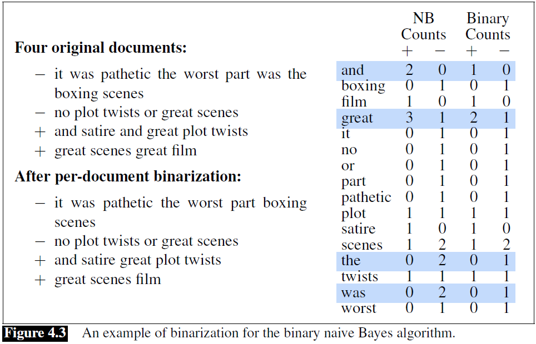
Optimizing for Sentiment Analysis

Slide 67
Optimizing for Sentiment Analysis
An important addition commonly made when doing text classification for sentiment is to deal with negation.
Consider the difference between “I really like this movie” (positive) and “I didn’t like this movie” (negative).
The negation expressed by didn’t completely alters the inferences we draw from the predicate “like.”

Slide 68
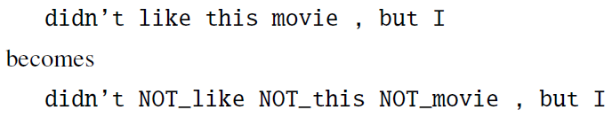
Optimizing for Sentiment Analysis
A very simple baseline that is commonly used in sentiment analysis to deal with negation is the following: during text normalization, prepend the prefix NOT_ to every word after a token of logical negation (n’t, not, no, never) until the next punctuation mark.

Slide 69
Optimizing for Sentiment Analysis
In some situations we might have insufficient labeled training data to train accurate naive Bayes classifiers using all words in the training set to estimate positive and negative sentiment.
In such cases we can instead derive the positive and negative word features from sentiment lexicons, lists of words that are pre-annotated with positive or negative sentiment.
Four popular lexicons are the General Inquirer (Stone et al., 1966), LIWC (Pennebaker et al., 2007), the opinion lexicon Hu and Liu (2004a) and the MPQA Subjectivity Lexicon (Wilson et al., 2005).
For example the MPQA subjectivity lexicon has 6885 words each marked for whether it is strongly or weakly biased positive or negative. Some examples:

Slide 70
Evaluation: Accuracy, Precision, Recall, F-measure
Let's first address binary classifiers:
Is this email spam?
spam (+) or not spam (-)
Is this post about Delicious Pie Company?
about Del. Pie Co (+) or not about Del. Pie Co(-)
For each item (email document) we need to know whether our system called it spam or not.
We also need to know whether the email is actually spam or not, i.e. the human-defined labels for each document that we are trying to match.
We refer to human labels as the gold labels.

Slide 71
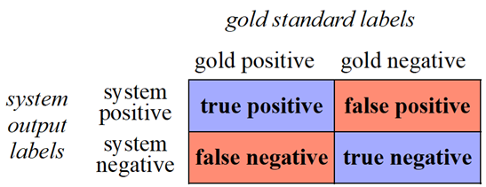
Confusion Matrix
To evaluate any system for detecting things, we start by building a confusion matrix.
A confusion matrix is a table for visualizing how an algorithm performs with respect to the human gold labels, using two dimensions (system output and gold labels), and each cell labeling a set of possible outcomes.

Slide 72
Accuracy

Slide 73
Precision & Recall
Accuracy doesn't work well when we're dealing with uncommon or imbalanced classes
Suppose we look at 1,000,000 social media posts to find Delicious Pie-lovers (or haters)
100 of them talk about our pie
999,900 are posts about something unrelated
Imagine the following simple classifier
Every post is "not about pie"

Slide 74
Precision & Recall
Accuracy of our "nothing is pie" classifier
999,900 true negatives and 100 false negatives
Accuracy is 999,900/1,000,000 = 99.99%!
But useless at finding pie-lovers (or haters)!!
Which was our goal!
Accuracy doesn't work well for unbalanced classes
Most tweets are not about pie!

Slide 75
Precision & Recall
Precision: % of selected items that are correct
Precision measures the percentage of the items that the system detected (i.e., the system labeled as positive) that are in fact positive (i.e., are positive according to the human gold labels).
Recall: % of correct items that are selected
Recall measures the percentage of items actually present in the input that were correctly identified by the system.

Slide 76
Precision & Recall
Stupid classifier: Just say no: every tweet is "not about pie"
100 tweets talk about pie, 999,900 tweets don't
Accuracy = 999,900/1,000,000 = 99.99%
But the Recall and Precision for this classifier are terrible:

Slide 77
F1- Score
F1 is a combination of precision and recall.

Slide 78
References
Daniel Jurafsky and James H. Martin. Speech and Language Processing, 3rd edition, 2024.
Hobson Lane and Maria Dyshel. Natural Language Processing in Action, 2nd Edition, 2025.
https://www.analyticsvidhya.com/blog/2022/03/building-naive-bayes-classifier-from-scratch-to-perform-sentiment-analysis/
https://www.youtube.com/watch?v=YVC-L_lLQb4

